Slide 1

Code Storm

Slide 2

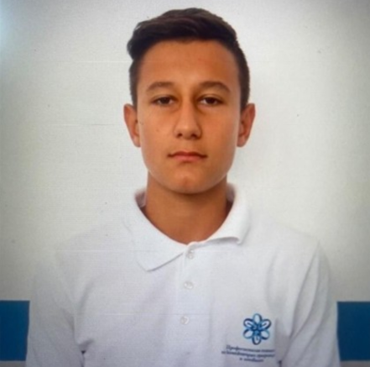
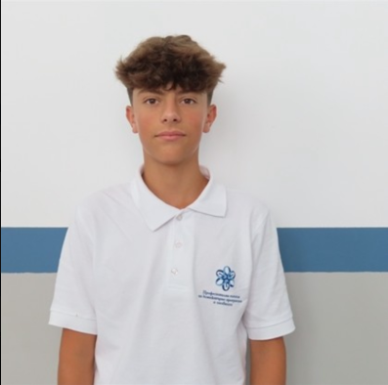
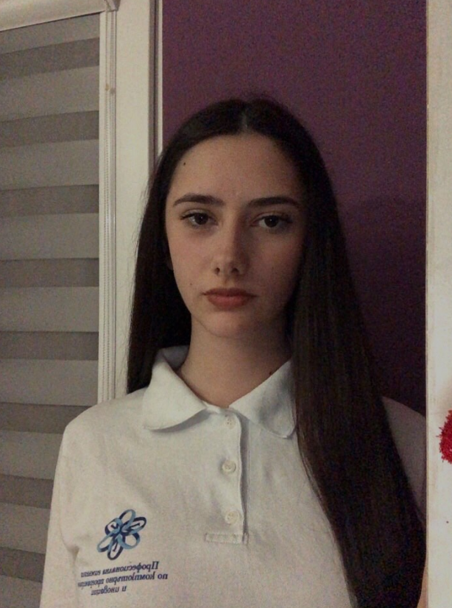
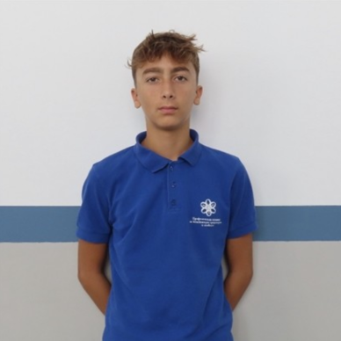
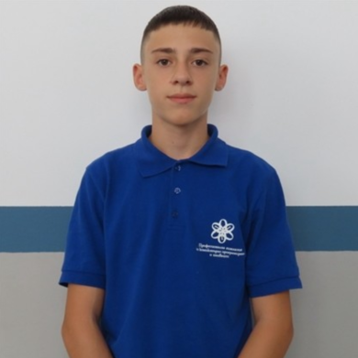
Неделин Манолов
Иван Динев
Backend developer
Frontend developer
Тодор Тороманов
Ирина Димова
Григор Сачаров
Designer
Scrum trainer
Frontend developer

Slide 3
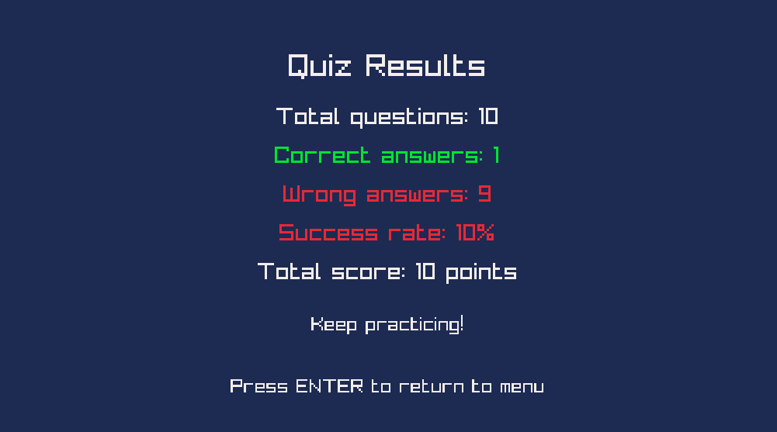
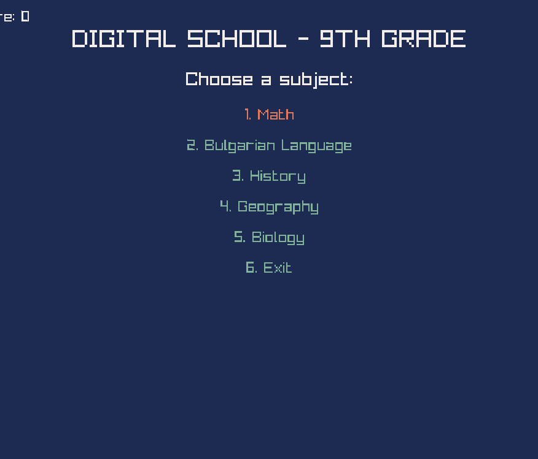
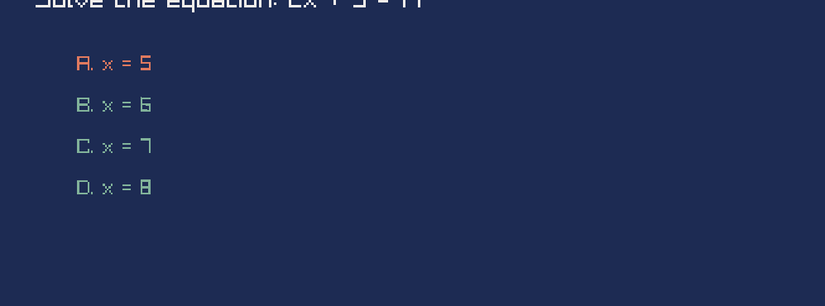
idea

Slide 4

Stages:
Choose an idea
Make an application
Make a design
Make a documentation

Slide 5








Slide 6
Let's hope to our game

